Slide 1
Trees & Forests
Anurag Srivastava

Slide 2
Agenda
Why do we need AI / ML?
CART
Decision Trees
Random Forests
Ensembles (Bagging / Boosting / Stacking)
1 image summary
When to use which algorithm
Sklearn vs. Statsmodels

Slide 3
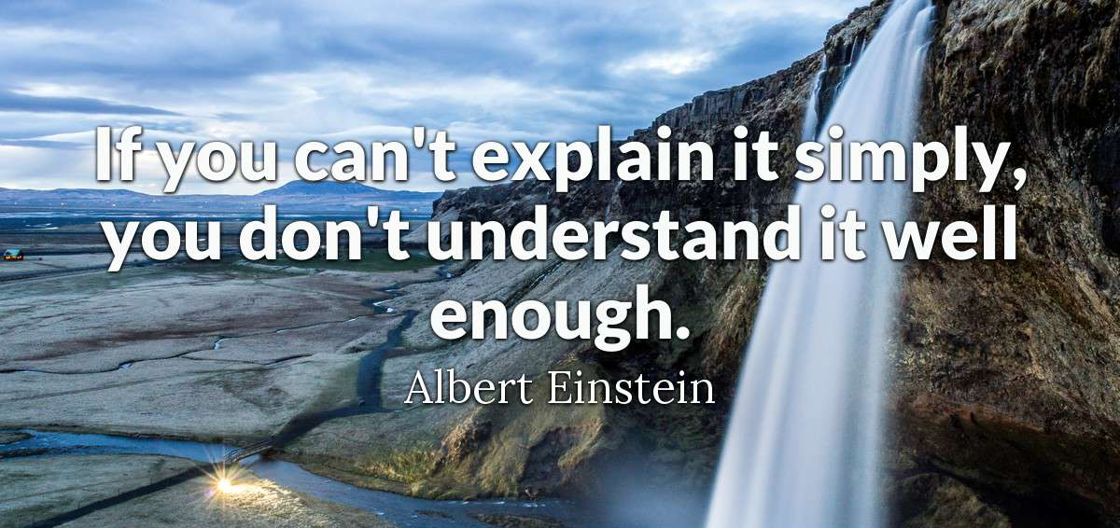

Slide 4
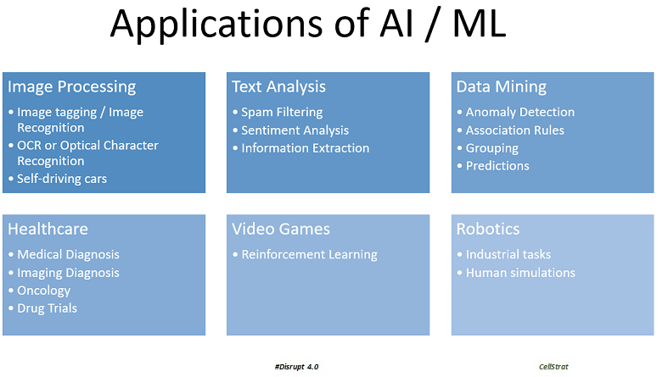
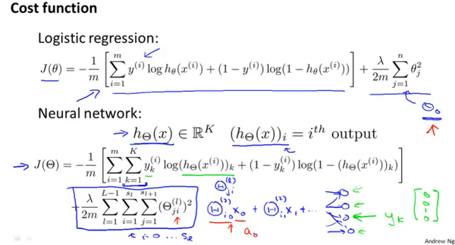
Approach to the course
✓
✗

Slide 5
The Progression
MIS
Predictive Analytics
Prescriptive Analytics
Data Mining
Data Analytics
Machine Learning
BI
Artificial Intelligence
Data Science

Slide 6
Roles / Profiles / Designation
AI Researcher
Client / CXO Interface
Product Owner
SME Coordination
Lead Data Scientist
Proof of Concept (PoC)
AI Developer
Execution of PoC
Scaling up
Development, Delivery & QA
AI DBA
Hadoop Stack Administration (Ambari)
Data Scientist

Slide 7
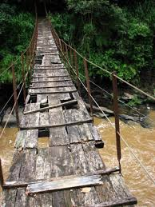
Why AI? Let us Intuit.
Would you cross this bridge?

Slide 8
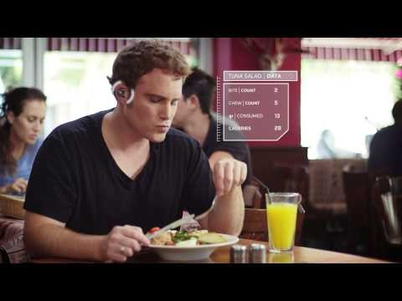
Examples of AI Systems - BitBite
https://www.youtube.com/watch?v=qU2w_qiP4Ck

Slide 9
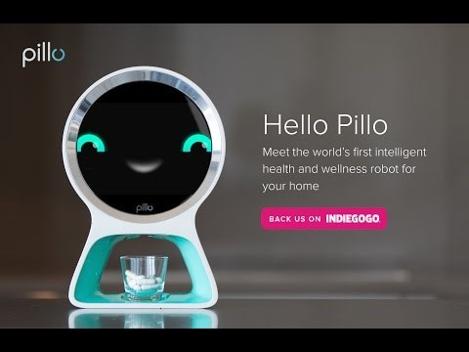
Examples of AI Systems - Pillo
https://www.youtube.com/watch?v=GfjGPTKBFB4&t=1s

Slide 10
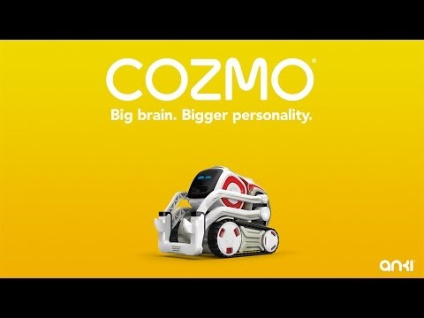
Examples of AI Systems - Cozmo
https://www.youtube.com/watch?v=cjFA531qJNE

Slide 11
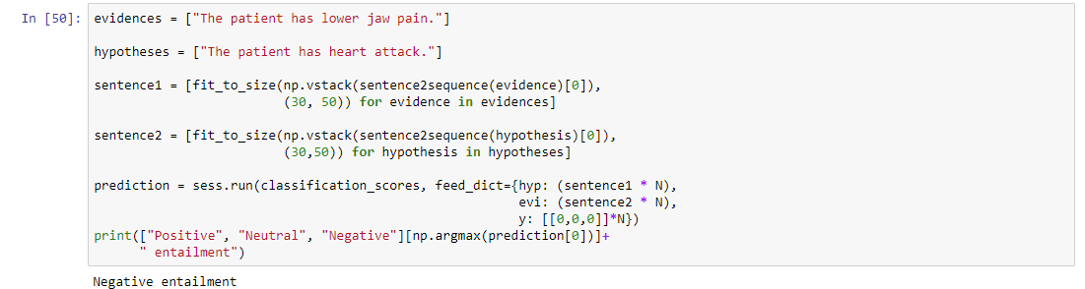
AI in Application

Slide 12
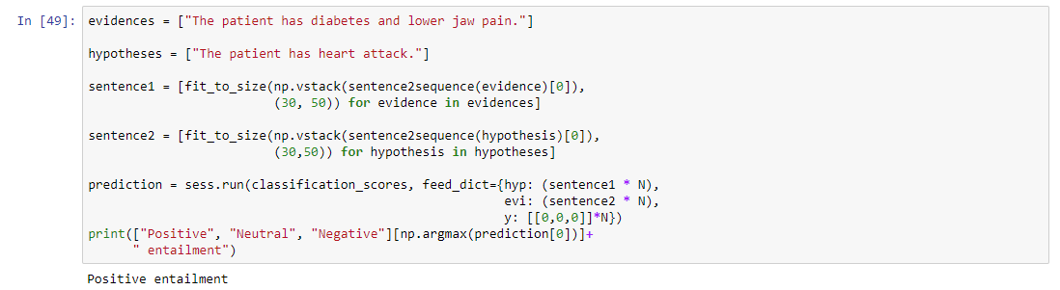
AI in Application

Slide 13
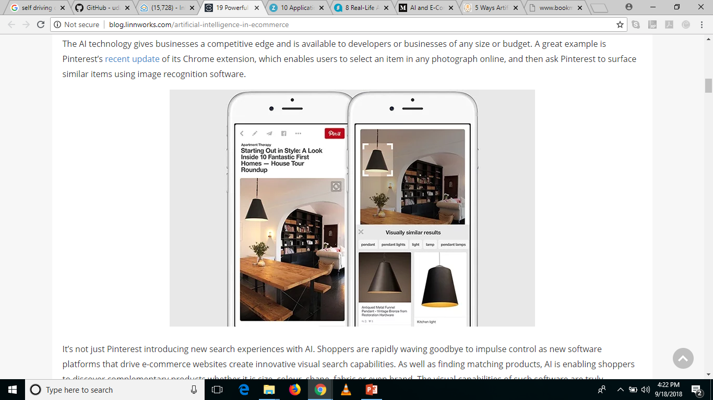
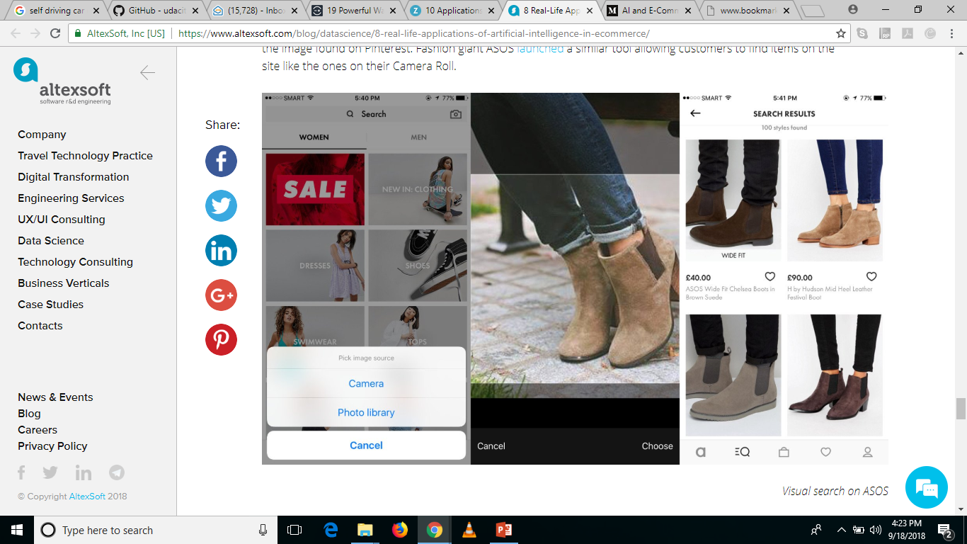
AI Use Case – e Commerce
App that suggests recipes using the inventory of your fridge – Chefling
Custom Search – Pinterest.

Slide 14
AI Use Case – e Commerce
Chatbots
Virtual Assistants
By using Alexa on Amazon’s Echo device, customers can discover local gigs for the upcoming weekend through StubHub, arrange transport to and from the event via Uber, or even order pre-event dinner from Domino’s (and track the order status in real time).
Wish
On the spot personal pricing
Tackle fake reviews
www.fakespot.com
Inventory Management & Sales Forecasting
Generating product descriptions in any writing style

Slide 15
Imagine Real Time Modules
Deception detection in speech
Image verification – KYC – document photo and selfie
Reading handwritten forms / applications (any language)
Intuitive client risk profiling (social media data + financial data)
Voice based initial screening of loan applicants - https://www.youtube.com/watch?v=oUf9_rS1fYg
Transactional bots - digital assistants helping users navigate their finance plans, savings, and spending based on web footprints.
OCR can be used to digitize hard copy documents. An NLP model with layered business logic can then interpret, record, and correct contracts at high speed.

Slide 16
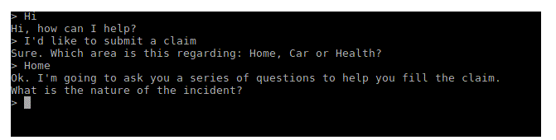
Transactional Bots
Automated Claims Processes –
Walks the customer through the process, step by step, in a conversational format.
It asks for videos or photos of the damage and uploads them to the database. It takes in all the information required for the processing of the claim. The bot can then run the application through a fraud detection method, looking for anomalies and non-compliant data.
It then moves on to the adjustment model where it provides a range of values for payout. Once all data is set, human intervention can be included for auditing purposes. The bot can at this point calculate and propose payout amounts, based on a payout predictor model it has been trained on.

Slide 17
Transactional Bots
AI assistance with claims settlement is fast and more successful.
And fast means — 3 seconds from claim submission to payment. This is the result of the independent work of Lemonade’s AI - Jim.
Lemonade is a New York based Insurance startup.
What AI can do is to assist, advise, and create a better customer experience. At the moment, AI complements human work and makes it more efficient, but it isn’t aimed to replace a human.

Slide 18
Classification
Classification is a data mining technique used for systematic placement of group membership of data.
It maps the data into predefined groups or classes and searches for new patterns.
For example, you may wish to use classification to predict whether the weather on a particular day will be “sunny”, “rainy”, or “cloudy”.

Slide 19
Regression
Used to predict for individuals on the basis of information gained from a previous sample of similar individuals.
For example, A person wants do some savings for future and then It will be based on his current values and several past values. He uses a linear regression formula to predict his future savings.
It may also be used in modelling the effect of doses in medicines or agriculture, response of a customer to a mail and evaluate the risk that the client will not pay back the loan taken from the bank.

Slide 20
What is CART?
Classification And Regression Trees
Developed by Breiman, Friedman, Olshen, Stone in early 80’s.
Introduced tree-based modeling into the statistical mainstream, rigorous approach involving cross-validation to select the optimal tree.
One of many tree-based modeling techniques.
CART -- the classic
CHAID
C4.5
C5.0

Slide 21
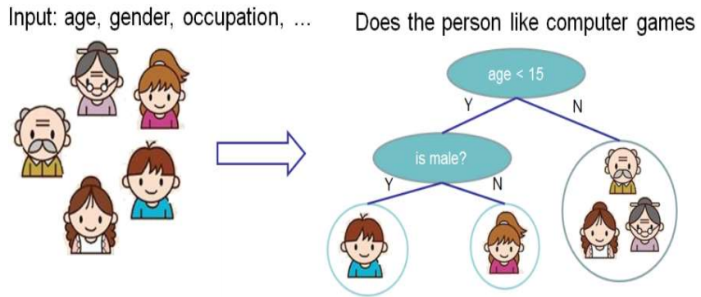
How do they work?

Slide 22
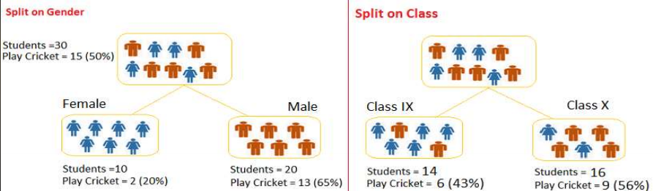
What?
If the dependent variable is categorical, CART produces a classification tree. And if the variable is continuous, it produces a regression tree.

Slide 23
The key idea
Take all of your data.
Consider all possible values of all variables.
Select the variable/value (X=t 1 ) that produces the greatest “separation” in the target.
(X=t1 ) is called a “split”.
If (X< t1 ) then send the data to the “left”; otherwise, send data point to the “right”.
Now repeat same process on these two “nodes”.
You get a “tree”
Note: CART only uses binary splits.

Slide 24
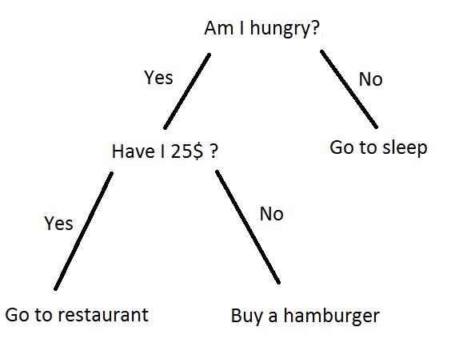
Decision Trees
A decision tree is a decision support tool that uses a tree-like model of decisions and their possible consequences, including chance event outcomes, resource costs, and utility.
Simply, A decision tree is a graphical representation of possible solutions to a decision based on certain conditions. It's called a decision treebecause it starts with a single box (or root), which then branches off into a number of solutions, just like a tree.

Slide 25
Wait, Cart Vs. Decision Trees?
Difference?
No difference….
Decision Tree – old name
CART – fancy modern name

Slide 26
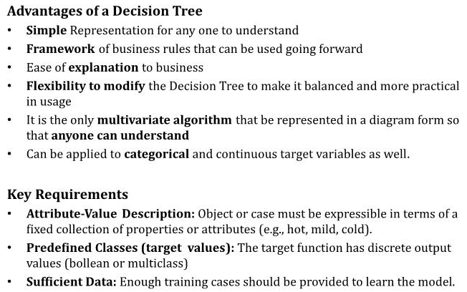
Advantages of Decision Trees

Slide 27
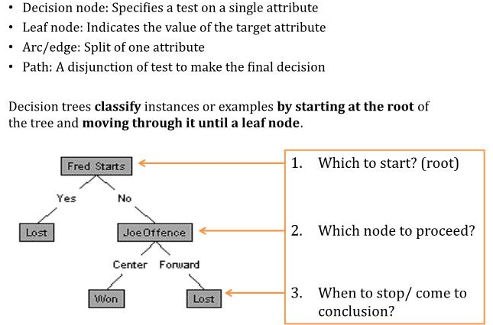
Components of Decision Trees

Slide 28
Training Data
Day
Outlook
Temp.
Humidity
Wind
Play Tennis
D1
Sunny
Sunny
Hot
High
Weak
No
D2
Sunny
Hot
High
Strong
No
D3
Overcast
Hot
High
Weak
Yes
D4
Rain
Mild
High
Weak
Yes
D5
Rain
Cool
Normal
Weak
Yes
D6
Rain
Cool
Normal
Strong
No
D7
Overcast
Cool
Normal
Weak
Yes
D8
Sunny
Mild
High
Weak
No
D9
Sunny
Cold
Normal
Weak
Yes
D10
Rain
Mild
Normal
Strong
Yes
D11
Sunny
Mild
Normal
Strong
Yes
D12
Overcast
Mild
High
Strong
Yes
D13
Overcast
Hot
Normal
Weak
Yes
D14
Rain
Mild
High
Strong
No

Slide 29
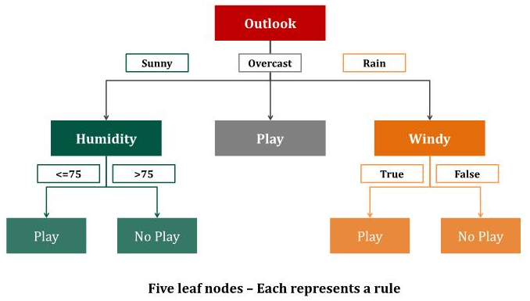
Decision Trees Rules: Sample

Slide 30
Decision Tree for PlayTennis
Outlook
Sunny
Overcast
Rain
Humidity
Each internal node tests an attribute
High
Normal
Each branch corresponds to an
attribute value node
No
Yes
Each leaf node assigns a classification

Slide 31
Word Sense Disambiguation
Given an occurrence of a word, decide which sense, or meaning, was intended.
Example: "run"
run1: move swiftly (I ran to the store.)
run2: operate (I run a store.)
run3: flow (Water runs from the spring.)
run4: length of torn stitches (Her stockings had a run.)
etc.

Slide 32
Word Sense Disambiguation
Categories
Use word sense labels (run1, run2, etc.) to name the possible categories.
Features
Features describe the context of the word we want to disambiguate.
Possible features include:
near(w): is the given word near an occurrence of word w?
pos: the word’s part of speech
left(w): is the word immediately preceded by the word w?
etc.

Slide 33
Word Sense Disambiguation
Example decision tree:
(Note: Decision trees for WSD tend to be quite large)
pos
noun
verb
near(stocking)
near(race)
yes
no
yes
no
run4
run1
near(river)
yes
no
run3

Slide 34
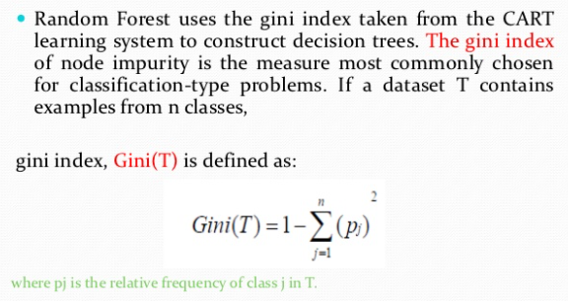
How is a tree created?
GINI impurity

Slide 35
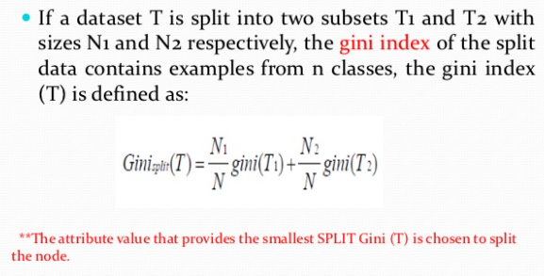
How is a tree created?

Slide 36
Alternatively you can use
Entropy and Information Gain but they work with different algorithms
https://thatascience.com/learn-machine-learning/gini-entropy/#:~:text=Decision%20tree%20algorithms%20use%20information,thermodynamics%20where%20it%20signifies%20disorder.

Slide 37
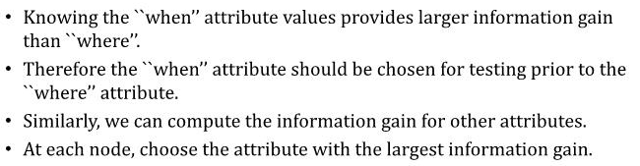
Decision Making

Slide 38
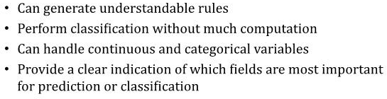
Strength

Slide 39
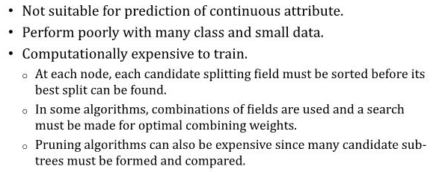
Weakness

Slide 40
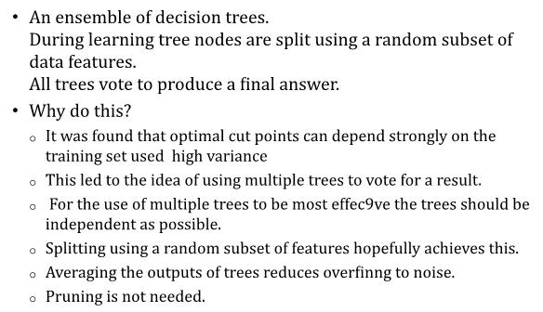
Random Forests

Slide 41
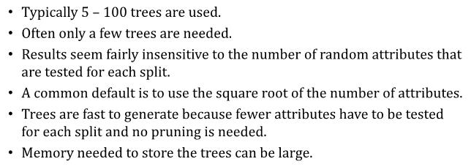
Random Forests

Slide 42
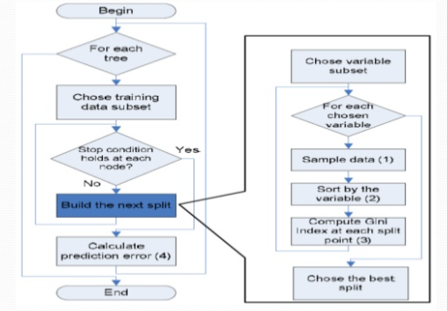
The working

Slide 43
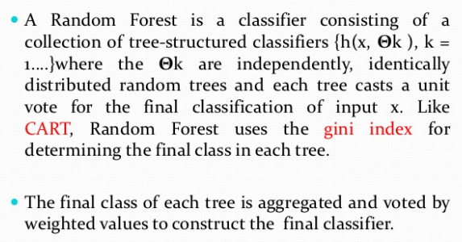
Random Forest

Slide 44
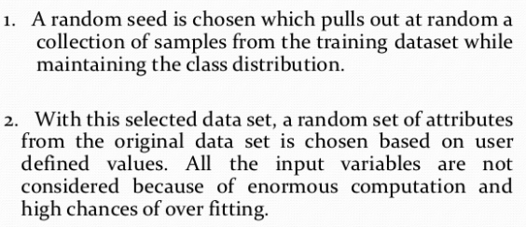
Example – how does it work?

Slide 45
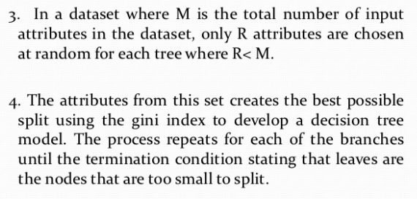
Example – how does it work?

Slide 46
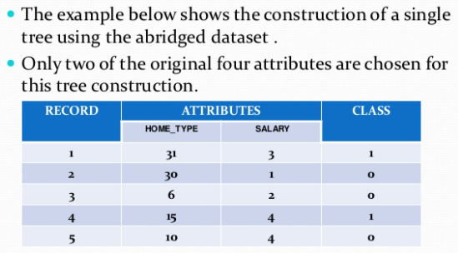
Example – how does it work?

Slide 47
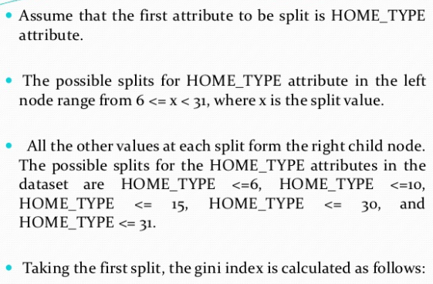
Example – how does it work?

Slide 48
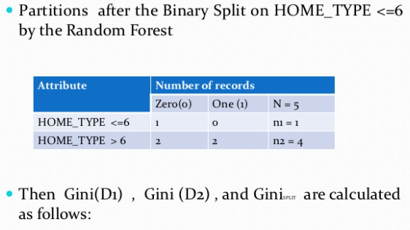
Example – how does it work?

Slide 49
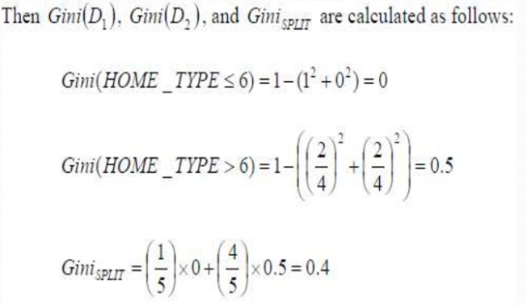
Example – how does it work?

Slide 50
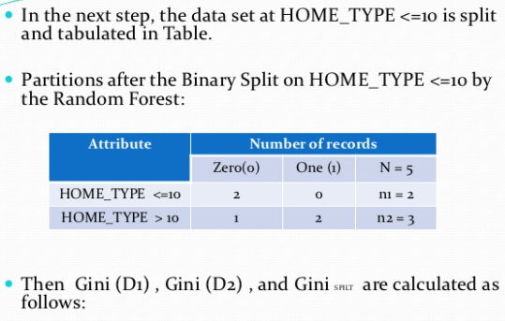
Example – how does it work?

Slide 51

Example – how does it work?

Slide 52
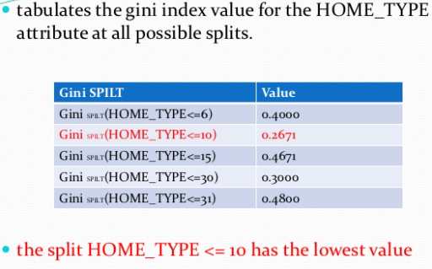
Example – how does it work?

Slide 53

Example – how does it work?

Slide 54

Example – how does it work?

Slide 55
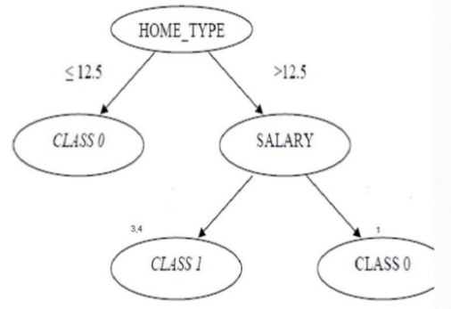
Example – how does it work?

Slide 56

Example – how does it work?

Slide 57
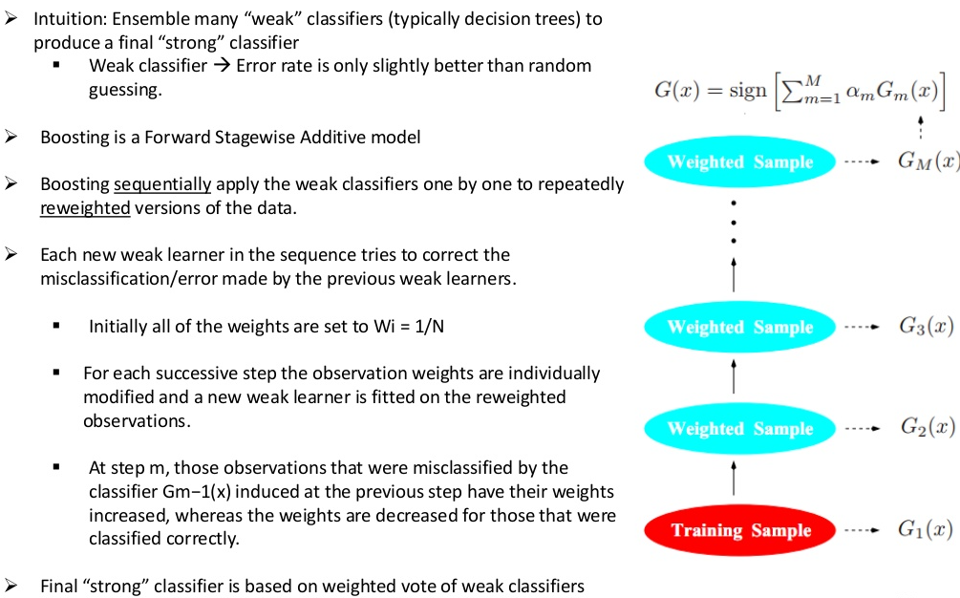
Boosting

Slide 58
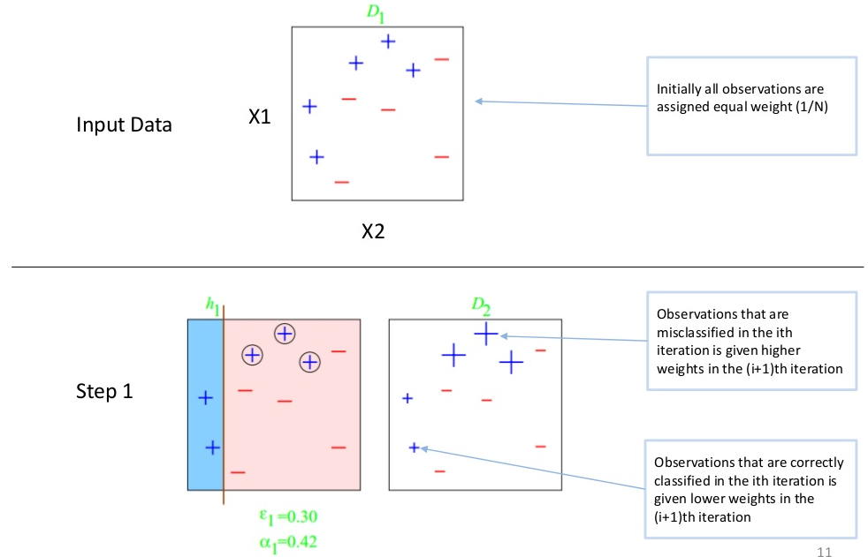
Boosting

Slide 59
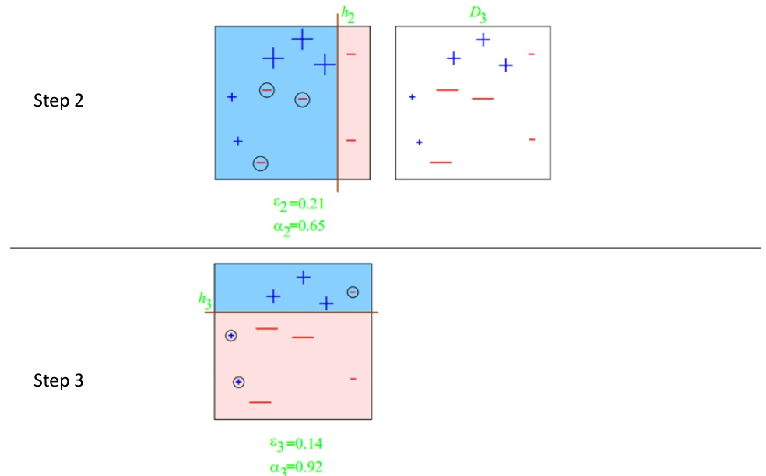
Boosting

Slide 60
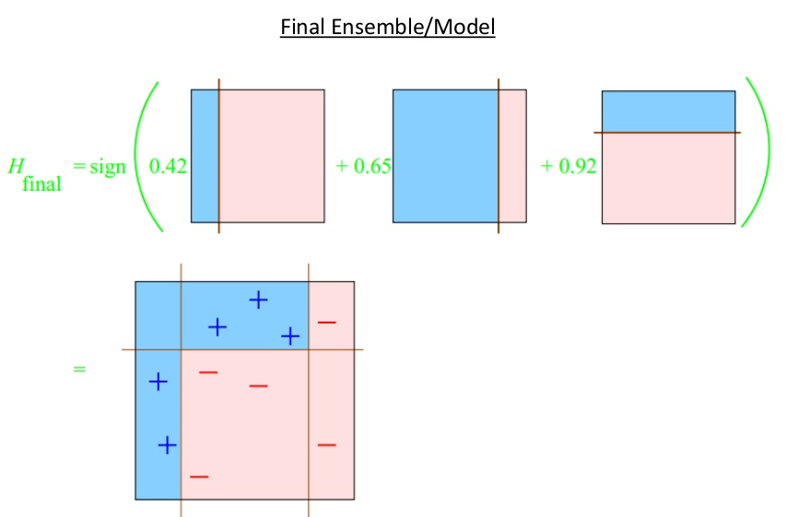
Boosting

Slide 61
Additional resources
https://www.datasciencecentral.com/profiles/blogs/decision-tree-vs-random-forest-vs-boosted-trees-explained
https://victorzhou.com/blog/intro-to-random-forests/
https://web.csulb.edu/~tebert/teaching/lectures/551/random_forest.pdf
https://towardsdatascience.com/the-ultimate-guide-to-adaboost-random-forests-and-xgboost-7f9327061c4f
https://medium.com/analytics-vidhya/comparing-random-forest-and-xgboost-be98578479c3
https://analyticsindiamag.com/random-forest-vs-xgboost-comparing-tree-based-algorithms-with-codes/

Slide 62
When to use which algo?
See text file.

Slide 63
Get holistic understanding using single dataset
https://machinelearningmastery.com/compare-machine-learning-algorithms-python-scikit-learn/

Slide 64
1 image summaries
Attached

Slide 65
Scikit Learn Vs. StatsModels
https://blog.thedataincubator.com/2017/11/scikit-learn-vs-statsmodels/

Slide 66
Questions?
Thank you!

